Slide 1
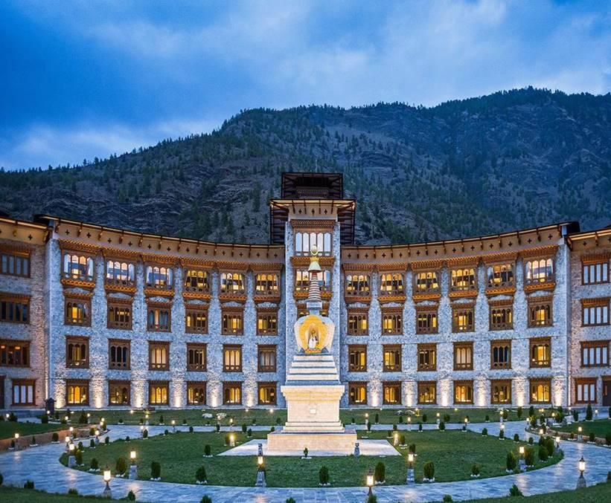
Hotel Prices in Bhutan
Team 3: Drupas

Slide 2
Group Members
Kinley Wangchuk
Dependra Basnet

Slide 3
Agenda
Objectives
Methodology
Conclusion
1.
3.
5.
2.
4.
Data Source
Results

Slide 4
Objectives
Data-Driven Insights:
Develop a model to predict hotel prices in Bhutan based on key factors such as location, tourist season, amenities, and proximity to major attractions.
Comprehensive Data Utilization:
Utilize data cleaning, feature selection, and regression analysis to identify trends and patterns in hotel pricing.
Visualization and Reporting:
Leverage hotel booking platforms and Bhutan-specific accommodation data to create a reliable dataset for analysis.

Slide 5
Enhancing Tourism Understanding:
Present actionable insights and predictions through professional visualizations and reports for stakeholders.
Provide valuable insights into Bhutan's tourism industry by analyzing the relationship between pricing, tourist behaviors, and geographic factors.

Slide 6
Data Source
Tourist hotels in Bhutan has be explored from websites :
Bhutan Interactive Data Portal: https://www.nsb.gov.bt/bhutan-interactive-data-portal/
World Bank Database: https://databank.worldbank.org/source/world-development-indicators#
•The Humanitarian Data Exchange: https://data.humdata.org/dataset/?groups=btn&q=&sort=score%20desc%2C%20last_modified%20desc&ext_page_size=25
Our World in Data: https://ourworldindata.org/search?q=Bhutan
Data World: https://data.world/datasets/bhutan
Kaggle: https://www.kaggle.com/datasets/

Slide 7
METHODOLOGY
Data Collection
Analysis
Visualization
Result
Used Selenium and BeautifulSoup to scrape hotel names and prices from Booking.com.
Saved the scraped data in a CSV file (bhutan_hotel.csv).
Identified the highest and lowest hotel prices using data from the CSV file.
Performed regression analysis to predict future prices.
Generated a bar graph to compare the highest and lowest prices.
Created a regression graph to visualize trends and predict hotel prices for the next 10 days.
Key insights and predictions were presented visually in a professional PowerPoint presentation.

Slide 8
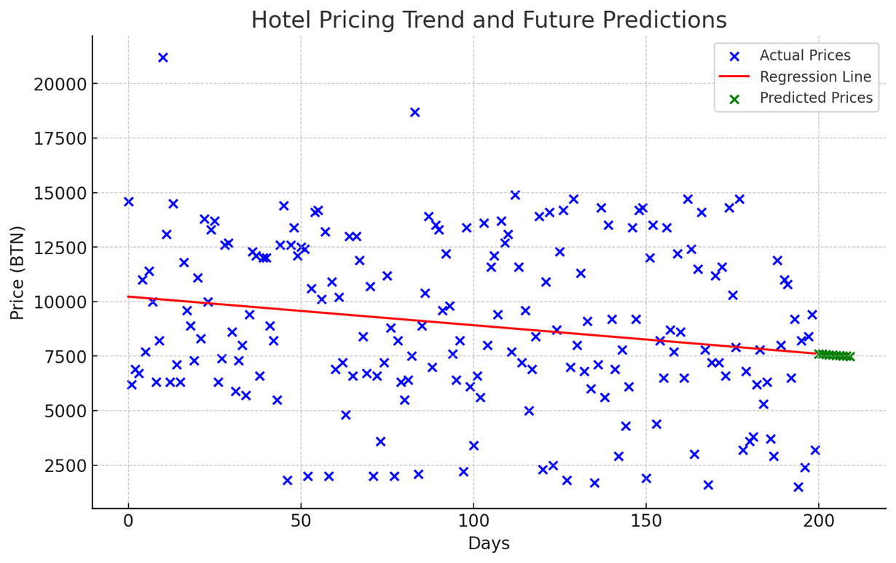
RESULTS:

Slide 9
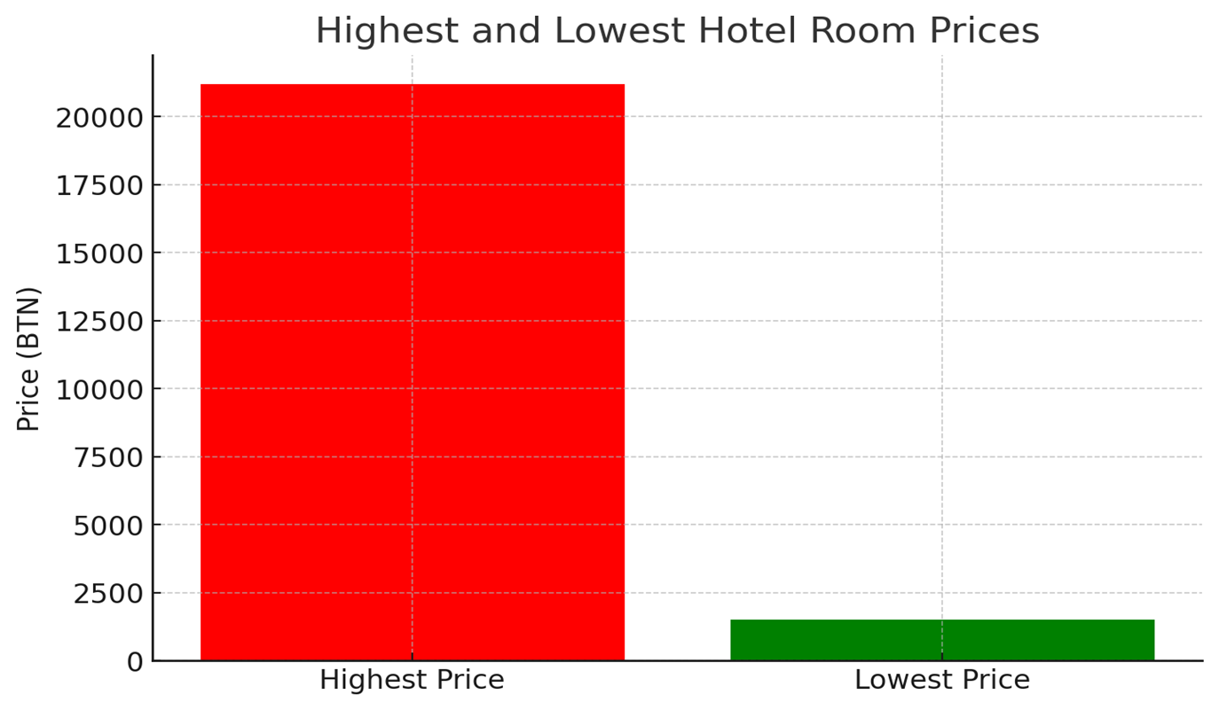

Slide 10
Observation
The highest actual price of the hotel between 0 to 5 days ranges from Nu.20,000 to Nu.25,000.
The lowest actual price of the hotel between 150 to 200 days ranges from 0 to Nu.2500.
The predicted price of the hotel after 200 days ranges from Nu.7500 to Nu. 10,000.
It is predicted that as the number of days increases the prices of highly charged hotels decreases.

Slide 11
Conclusion
Using python, data can be analyzed accurately to forecast the future prices of the hotels in the Bhutan.
Such data analysis helps policy and decision makers make suitable laws that promotes tourism and increase the revenue of the country.

